Slide 1
What did media say when talking about COVID-19:
Analysis of topics and sentiments of COVID-19 news headlines
TeamWFH
Chen Xingyu, Zeng Yi,
Zhou Yiyi, Jing Qianwen

Slide 2
01
INTRODUCTION

Slide 3
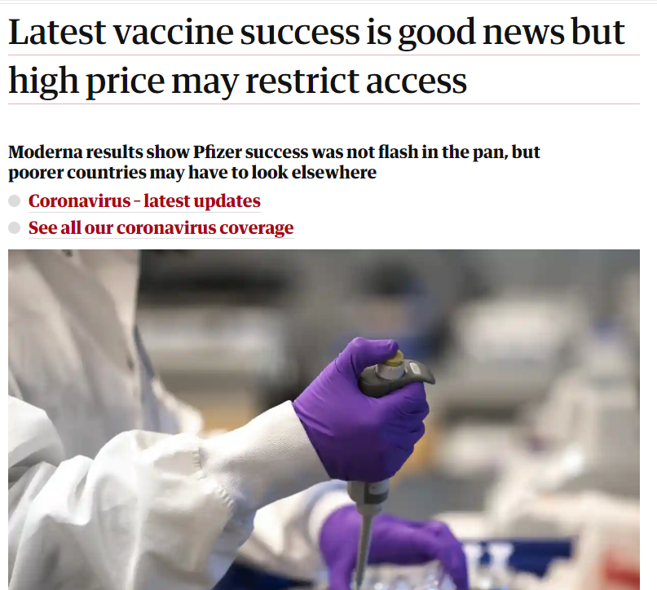
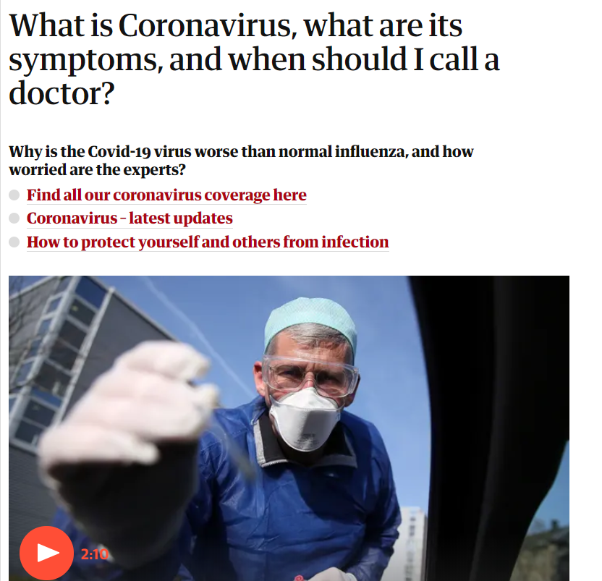
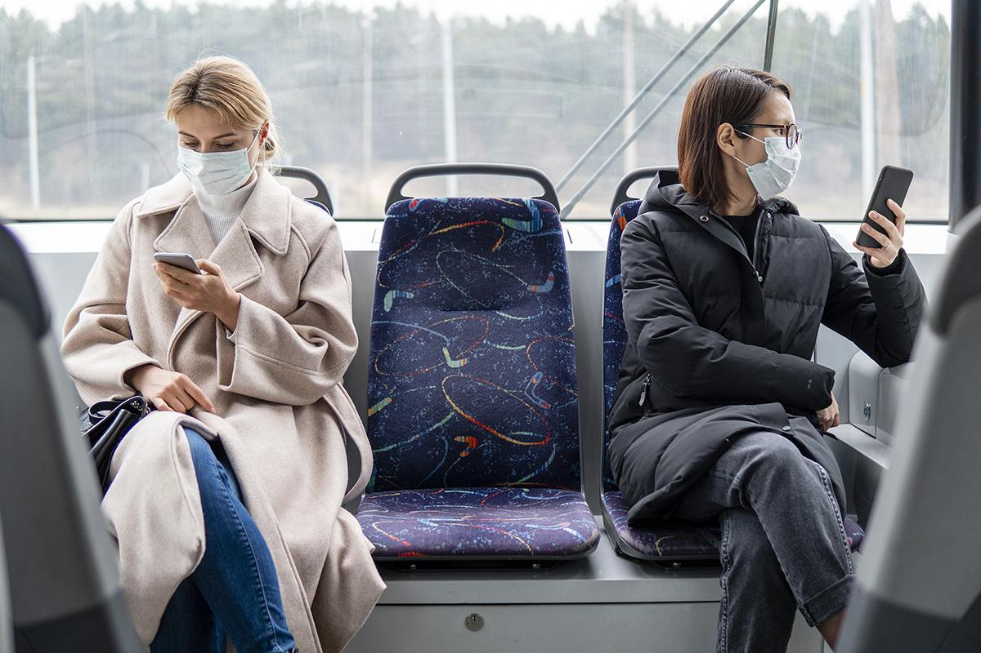
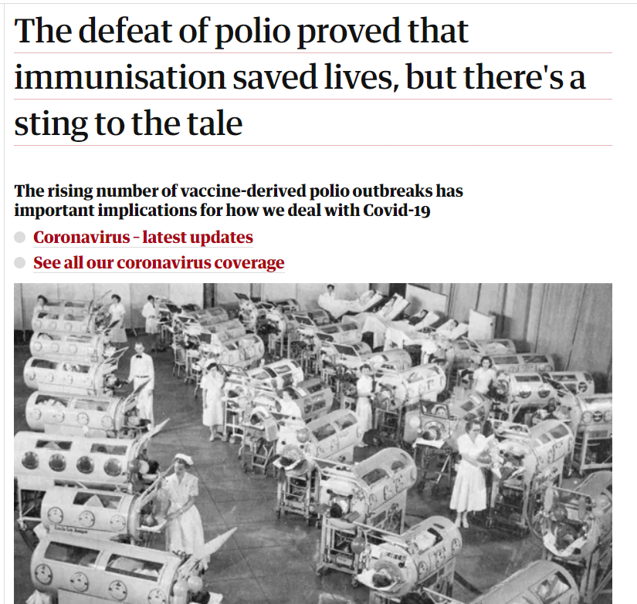
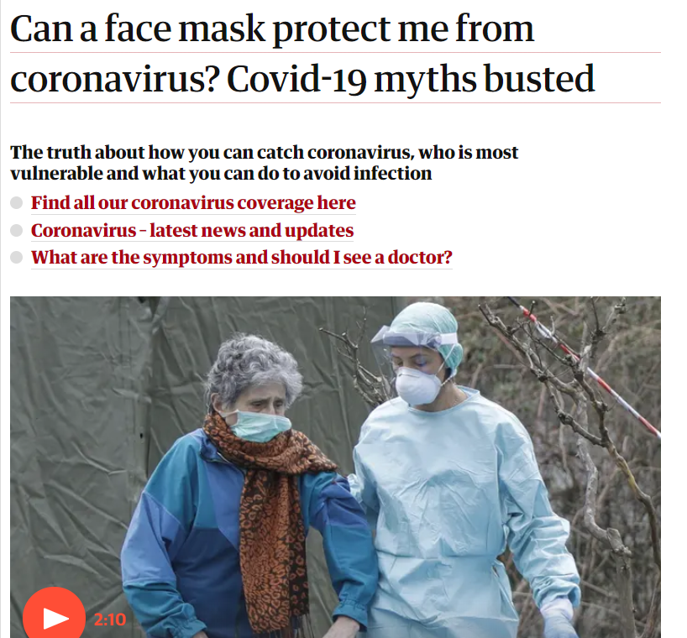
Background
The COVID-19 virus has continued to spread around the world and has a wide-ranging impact on society.
The COVID-19 pandemic has received worldwide public concern
Countless articles on COVID-19 presented in public media → media plays an important role in shaping people’s attitudes towards COVID-19

Slide 4





OBJECTIVE 1
OBJECTIVE 2
What are the sentiments of the news headlines?
What are the most common topics discussed based on news headlines?

Slide 5
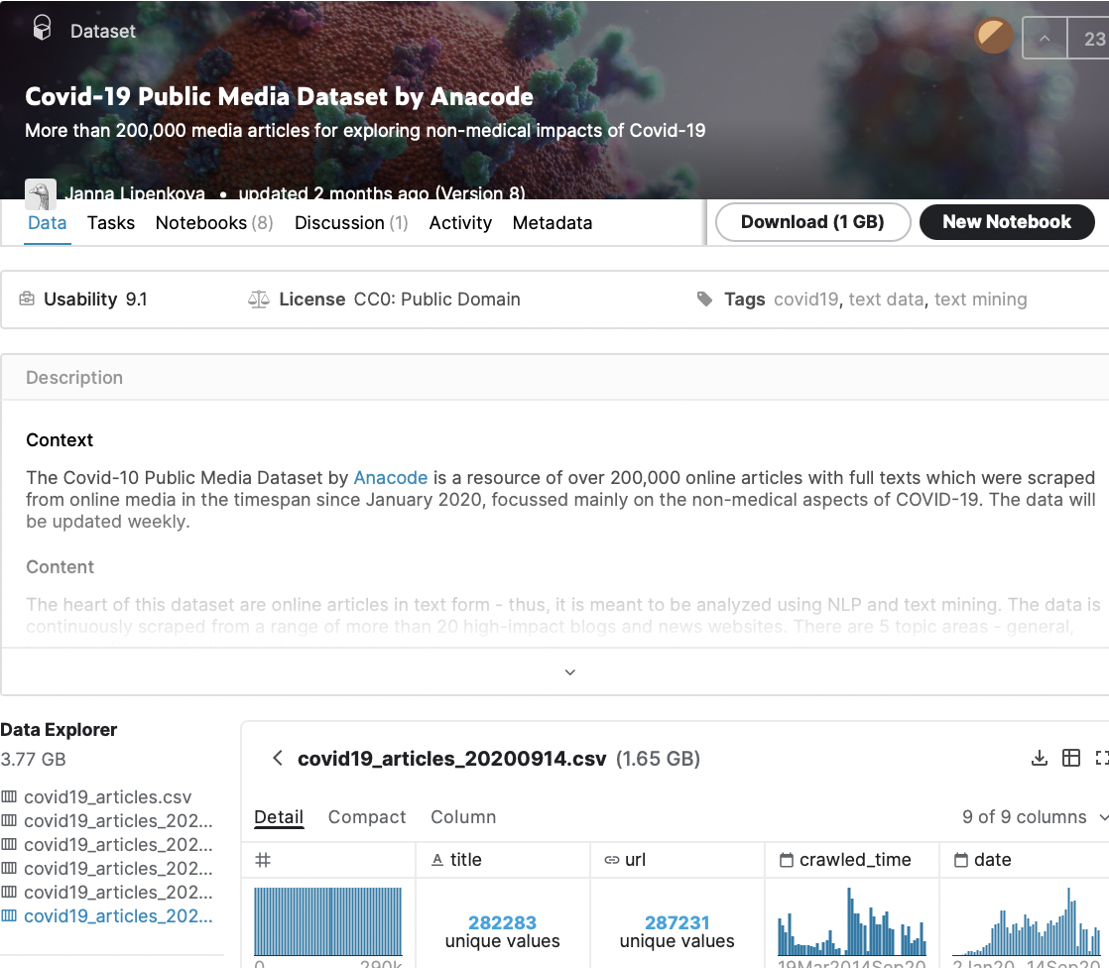
Dataset
https://www.kaggle.com/jannalipenkova/covid19-public-media-dataset
Kaggle Dataset -
Covid-19 Public Media Dataset
290,000+ articles
20+ high-impact blogs and news websites
From 2020-01-02 to 2020-09-14
General news, finance, science, technology…
‘title’, ‘date’, ‘content’, ‘author’, ‘topic_area’...

Slide 6
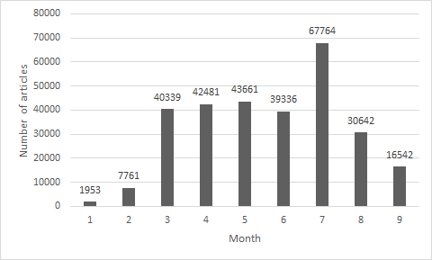
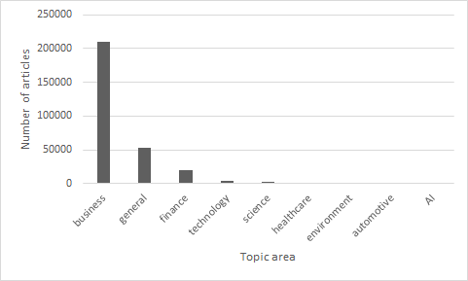
About the dataset

Slide 7
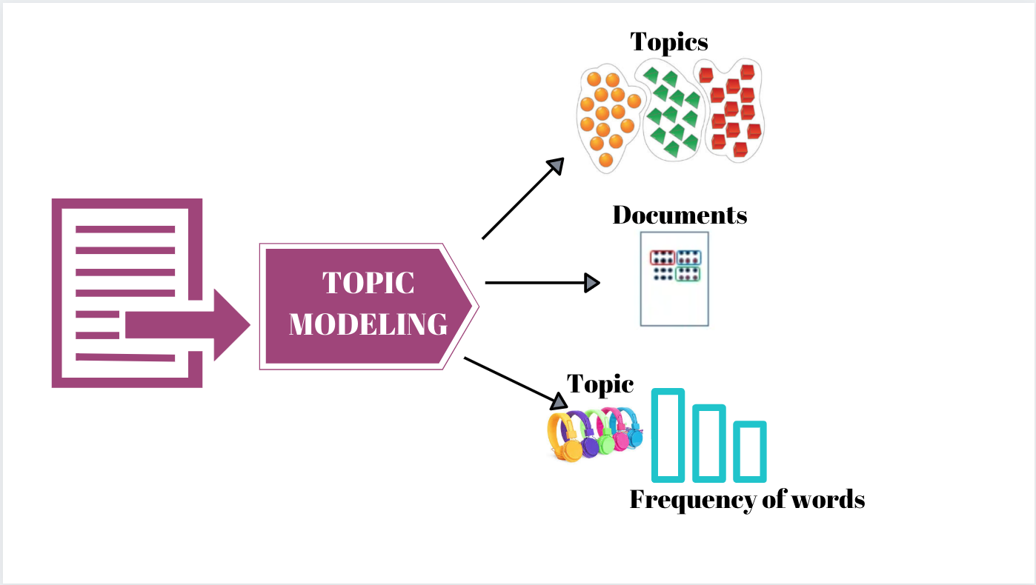
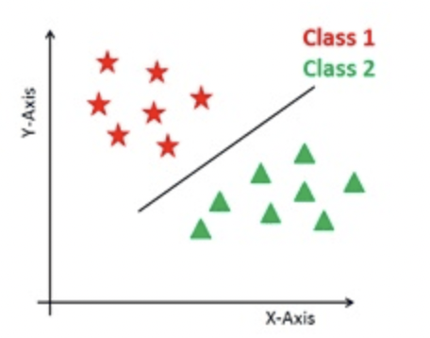

Method
Topic modeling
Topic classification
Sentiment Analysis
Latent Dirichlet Allocation
Multinomial NB
LR, SVM, Ensemble Learning (AdaBoostClassifier, Gradient Boosting), CNN, Vader

Slide 8
02
Sentiment Analysis

Slide 9
Sentiment Classification
PROBLEM
SOLUTION
Use IMDB Dataset to train models
Label 100 covid media data manually
Test and choose a good model strategy
Use the strategy to classify all data
Data has no label

Slide 10
Data pre-processing
50,000 data in IMDB Dataset
Train data: Test data = 50: 50
countVectoriser
Use nltk
Remove html tags, non-alphabet, short words (length < 3)
Tokenized
Filter out stop words in English

Slide 11
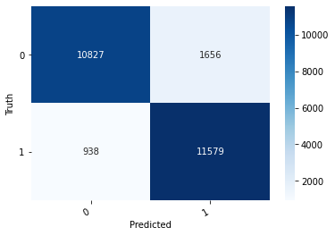
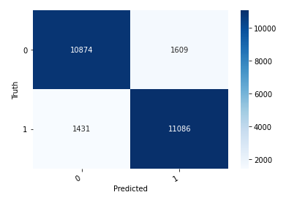
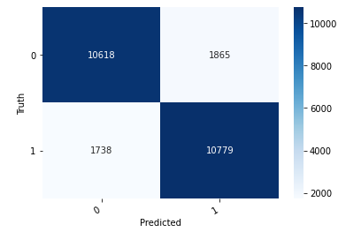
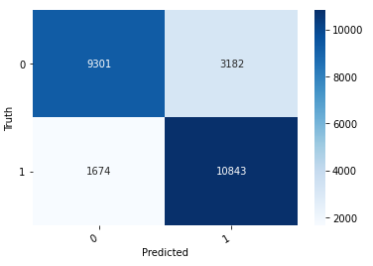
Training Models on IMDB data (Top 4 performers)
CNN Classifier accuracy: 0.90
Logistic Regression accuracy: 0.88
SVM accuracy: 0.86
Gradient Boosting accuracy: 0.81

Slide 12
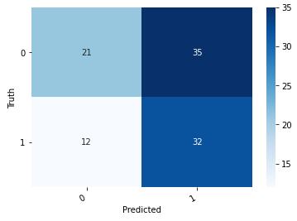
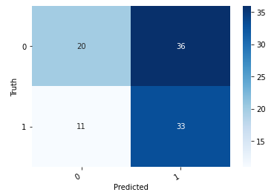
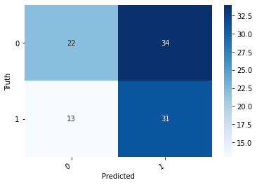
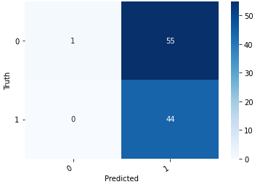
How models work on covid media data?
Logistic Regression accuracy: 0.53
SVM accuracy: 0.53
CNN Classifier accuracy: 0.53
Gradient Boosting accuracy: 0.45

Slide 13
Reasons for drop in accuracy
Difference in context
Spoken language vs written language
Models trained on IMDB data does not recognize words like ‘Covid’ (out-of-vocabulary)
Words like ‘increase’ tend to be positive in movie comments, but negative in covid news
Small amount of manually annotated covid media data
100 records may be too sensitive

Slide 14
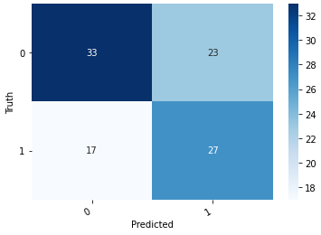
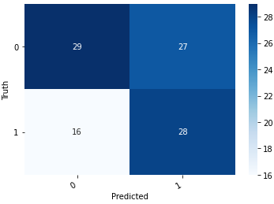
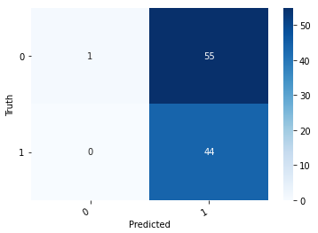
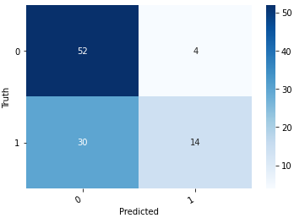
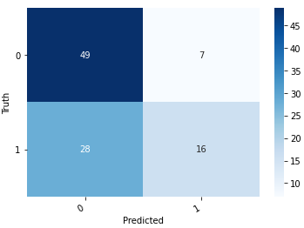
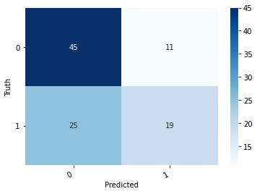
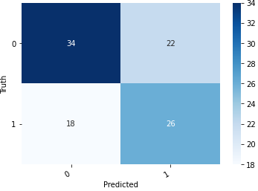
How models work on covid media data?
Model | Accuracy | Confusion matrix | Model | Accuracy | Confusion matrix
LR | 0.53 |  | LR+Vader+SVM+CNN* | 0.60
SVM | 0.53 |  | LR+Vader +CNN* | 0.57
ADA | 0.45 |  | LR+Vader* | 0.66
GB | 0.45 |  | Vader+CNN* | 0.65
Vader lexicon | 0.64 |  | LR+CNN* | 0.6
CNN | 0.53 |  | *hard voting used

Slide 15
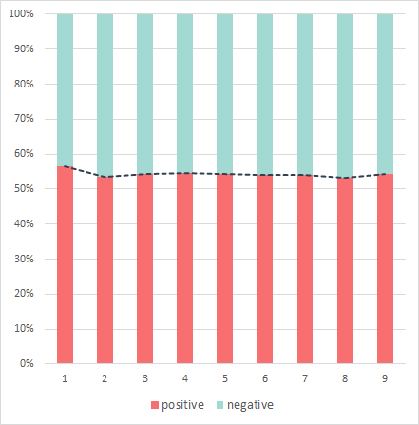
Sentiment Analysis
Positive vs Negative
156428 132380

Slide 16
03
Topic Analysis
Topic modeling & Topic classification

Slide 17
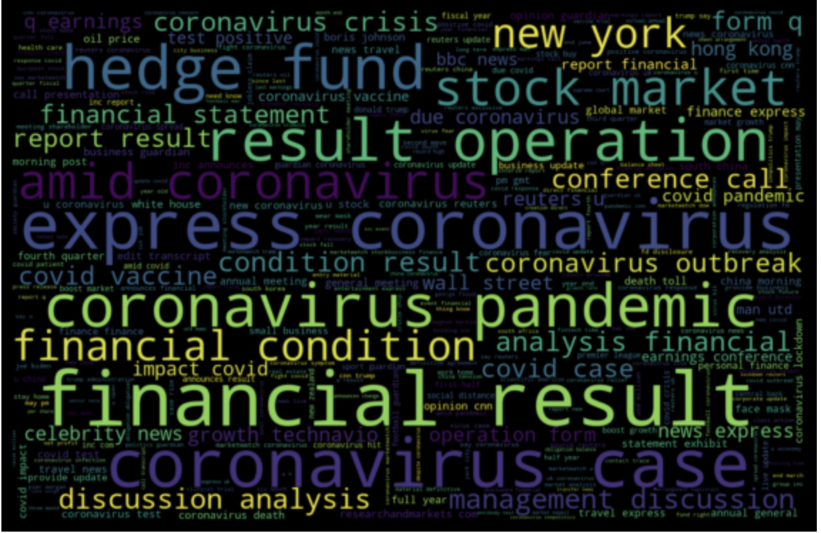
Data Pre-processing
Add words appear in multiple topics to stopwords list
Create the word cloud image
Cut the data by month
Word cloud

Slide 18
Results
Topic Modeling using LDA
month | topic number | coherence score | perplexity score
January | 4 | 0.7045 | -4.7261
February | 10 | 0.7208 | -6.2348
March | 12 | 0.6859 | -7.7935
April | 3 | 0.7455 | -50.4924
May | 13 | 0.7025 | -7.7305
June | 14 | 0.7139 | -7.8158
July | 9 | 0.7105 | -8.4281
August | 7 | 0.7296 | -7.2442
September | 5 | 0.7751 | -6.5777
All the coherence scores are between 0.68 to 0.78
All the perplexity scores are below-4, mostly between -6 to -9

Slide 19
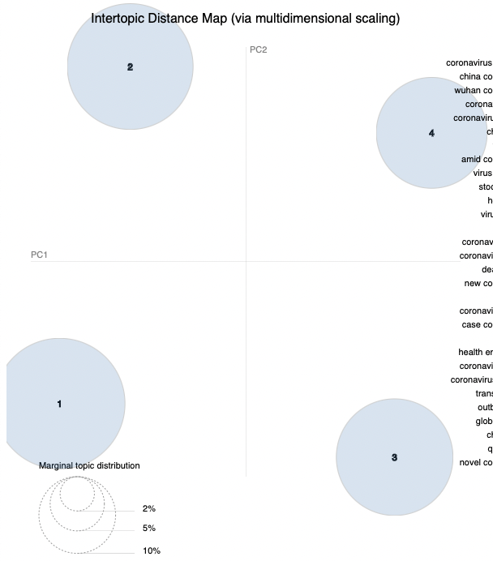
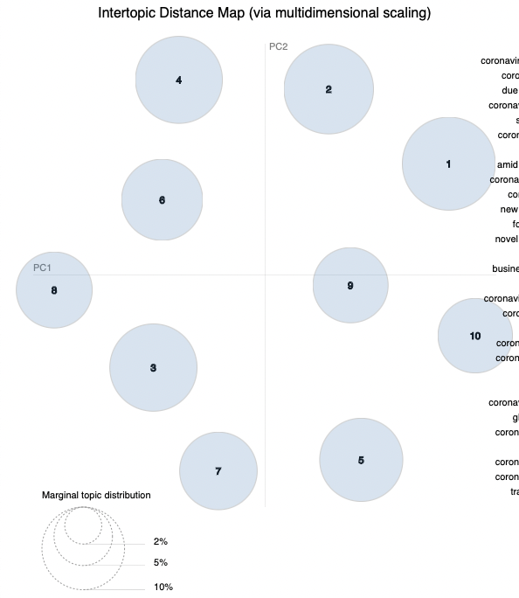
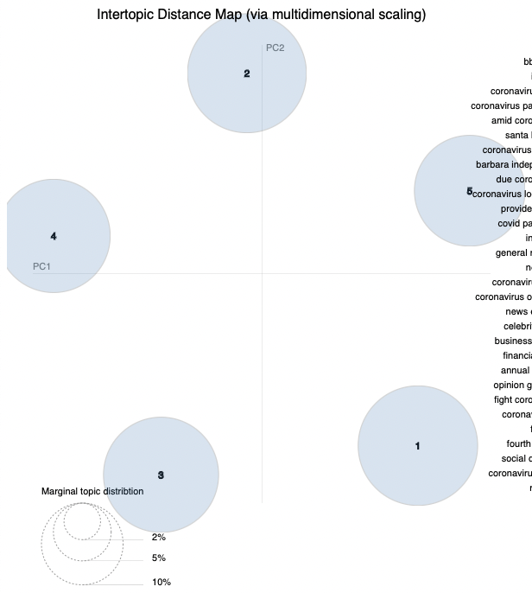
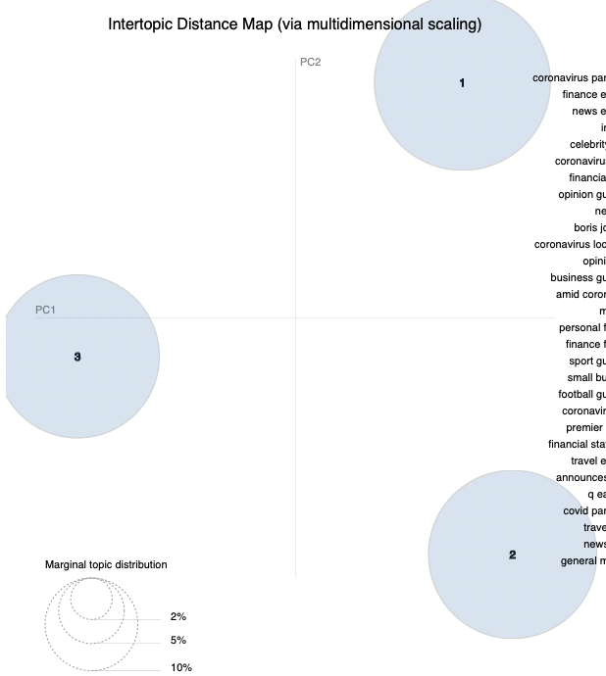
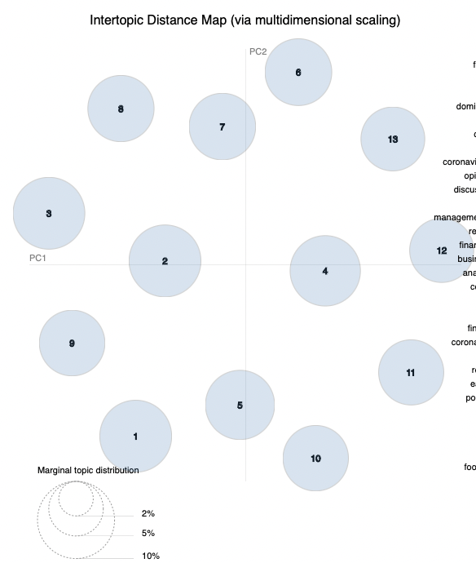
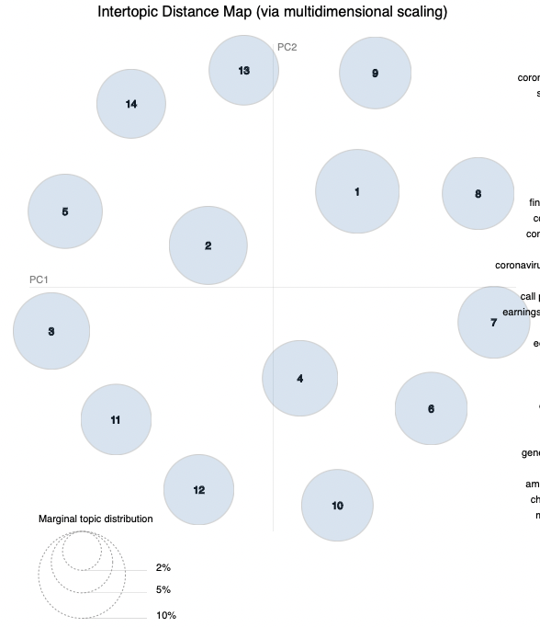
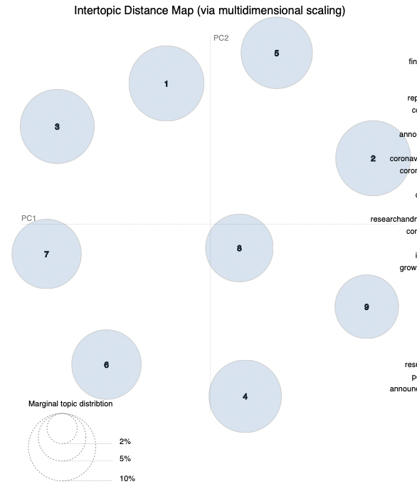
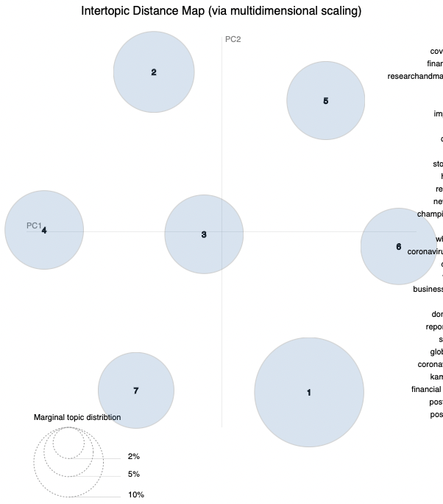
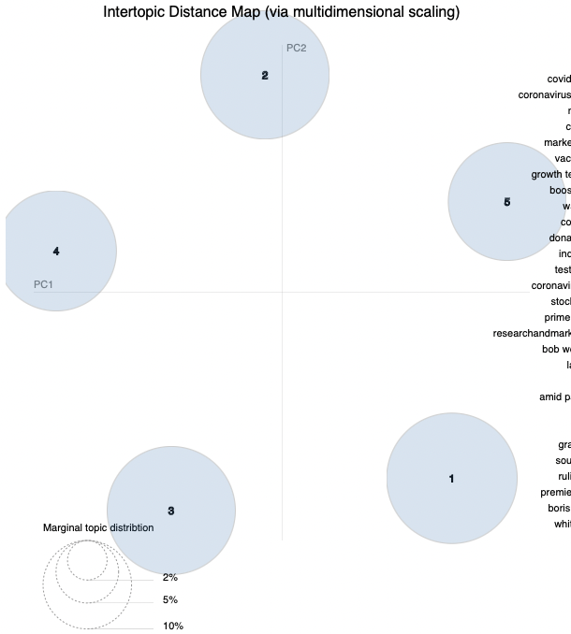
Results
Intertopic Distance Map (via pyLDAvis)

Slide 20
Results
topic | precision | recall | fl-score
1 | 0.53 | 0.7 | 0.6
2 | 0.75 | 0.94 | 0.83
3 | 0.91 | 0.84 | 0.87
4 | 0.83 | 0.77 | 0.8
5 | 0.87 | 1 | 0.93
6 | 0.97 | 0.67 | 0.8
7 | 0.83 | 0.68 | 0.75
8 | 0.95 | 0.76 | 0.84
9 | 0.80 | 0.8 | 0.8
10 | 0.89 | 0.77 | 0.82
11 | 0.95 | 0.85 | 0.9
12 | 0.76 | 0.92 | 0.83
13 | 0.94 | 0.96 | 0.95
14 | 0.98 | 0.90 | 0.94
15 | 0.92 | 0.90 | 0.91
16 | 0.93 | 0.90 | 0.91
17 | 0.88 | 1.00 | 0.93
18 | 0.93 | 1.00 | 0.97
19 | 0.83 | 0.92 | 0.87
20 | 0.98 | 0.98 | 0.98
21 | 1.00 | 1.00 | 1.00
22 | 1.00 | 0.72 | 0.84
23 | 1.00 | 1.00 | 1.00
24 | 0.77 | 1.00 | 0.87
weighted avg | 0.89 | 0.88 | 0.88
model | accuracy
topic classifier | 0.88
After merging the similar topics of each month, there finally are 24 topics.
Topics identified using LDA were used as input data to a multinomial NB classifier.

Slide 21
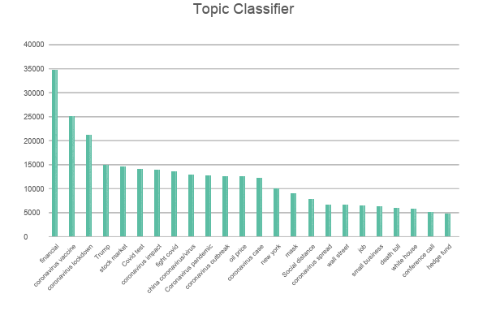
Analysis
The most 5 popular topics are:
financial
coronavirus vaccine
coronavirus lockdown
Trump
stock market

Slide 22
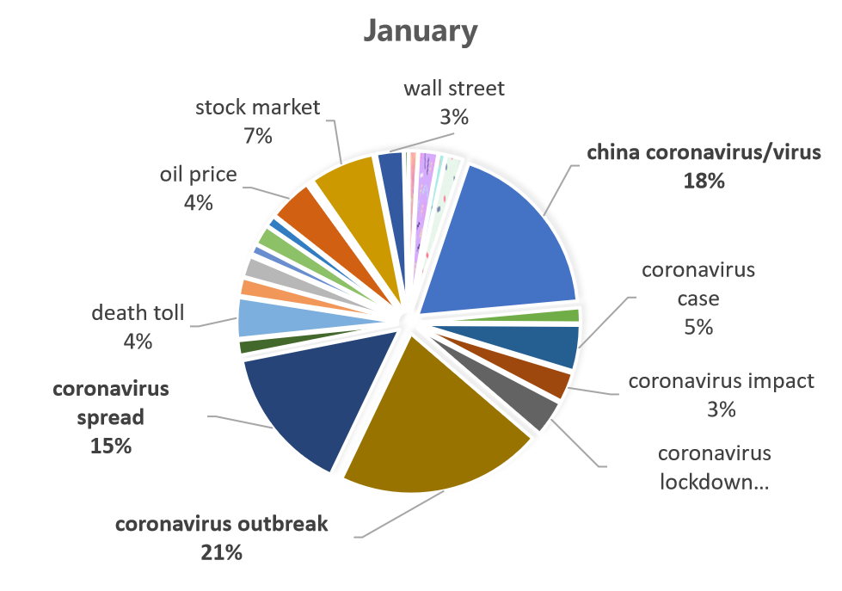
Analysis
most popular:
coronavirus outbreak
coronavirus spread china coronavirus
整体是coro，还有小部分的经济金融（油价，证券）

Slide 23
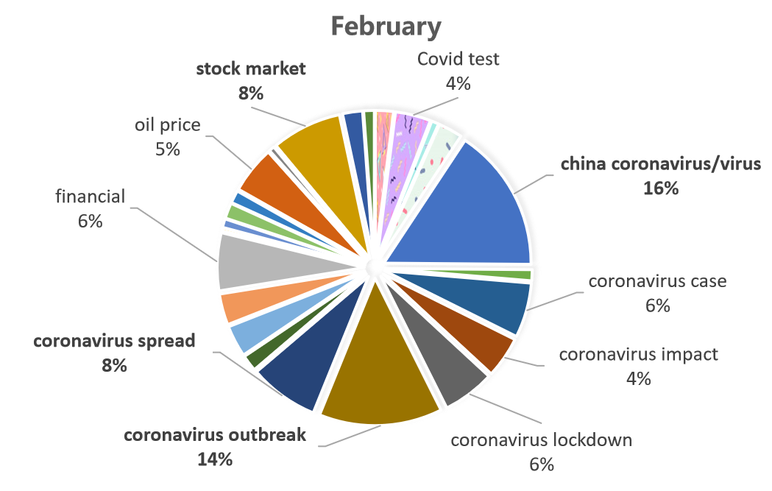
Analysis

Slide 24
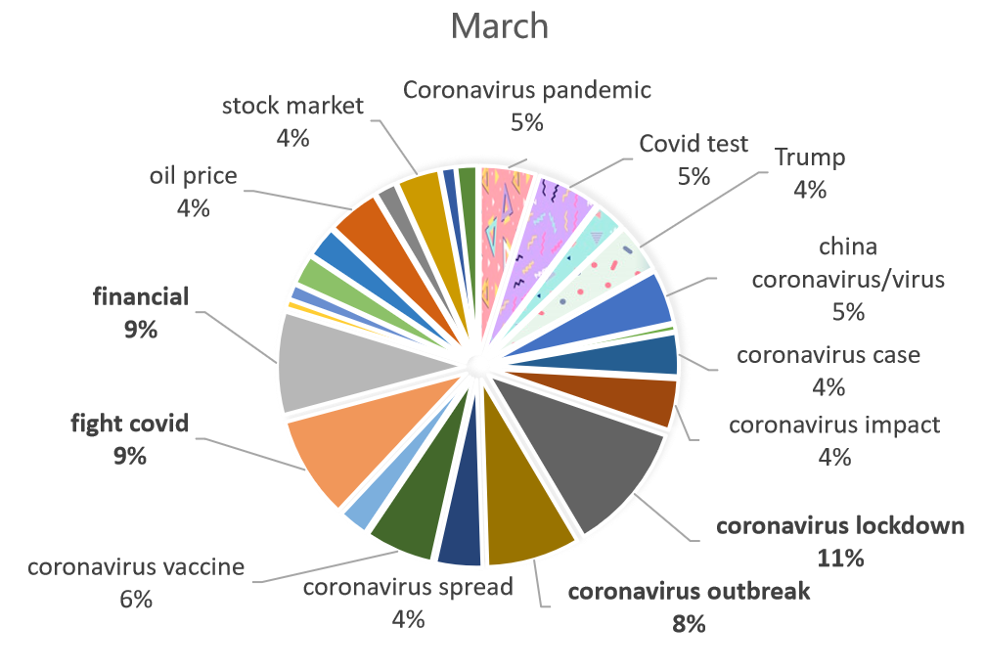
Analysis

Slide 25
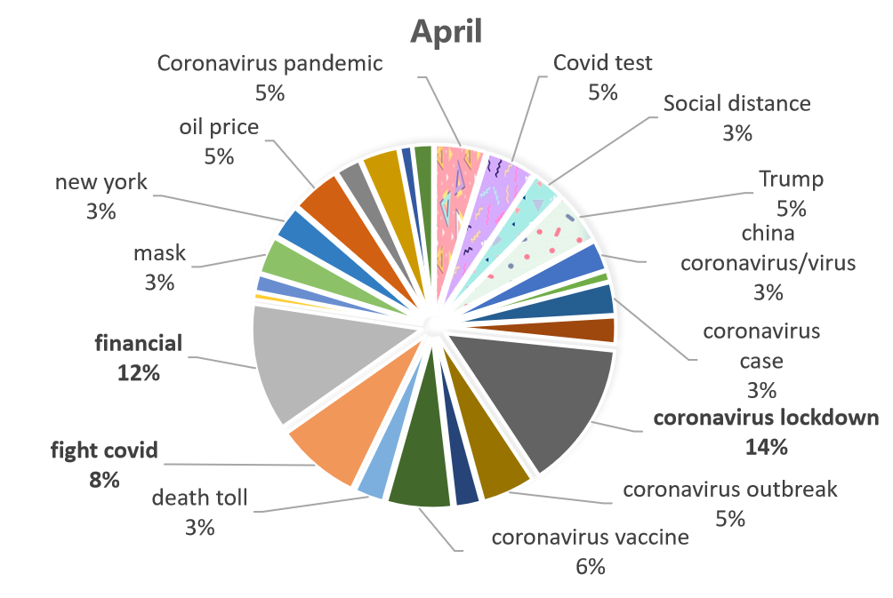
Analysis

Slide 26
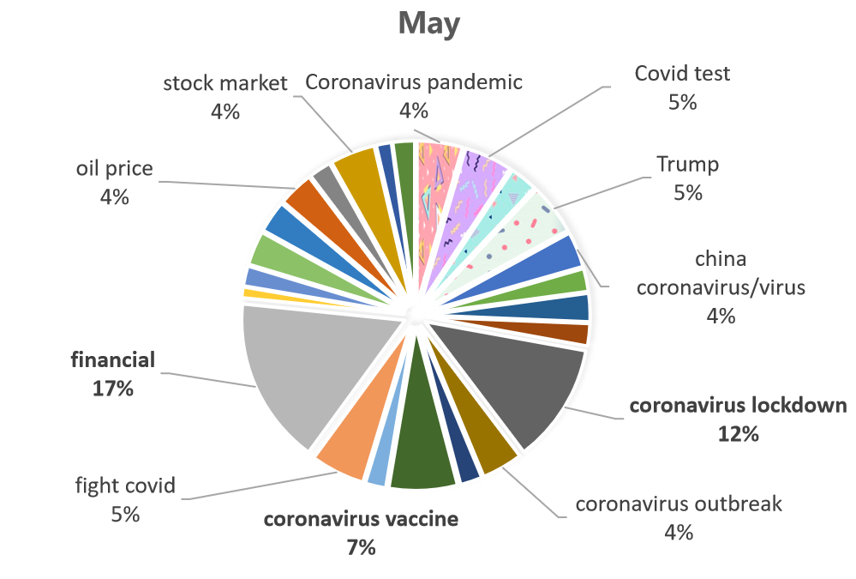
Analysis

Slide 27
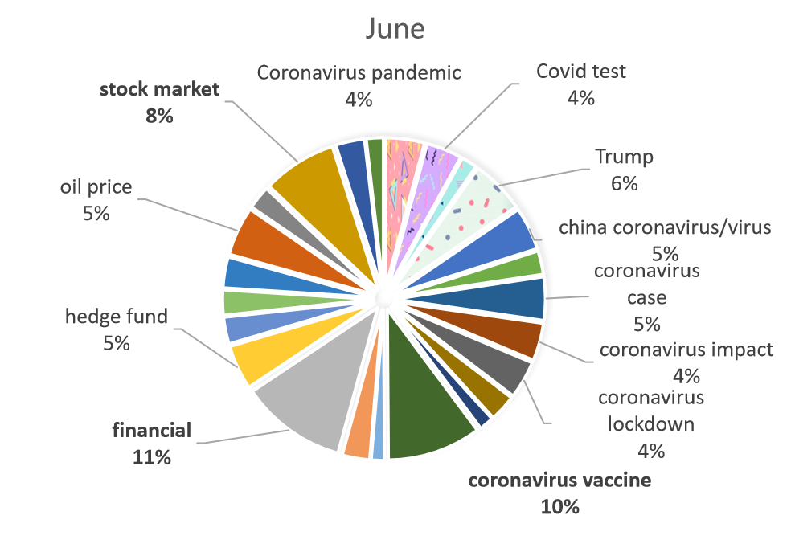
Analysis

Slide 28
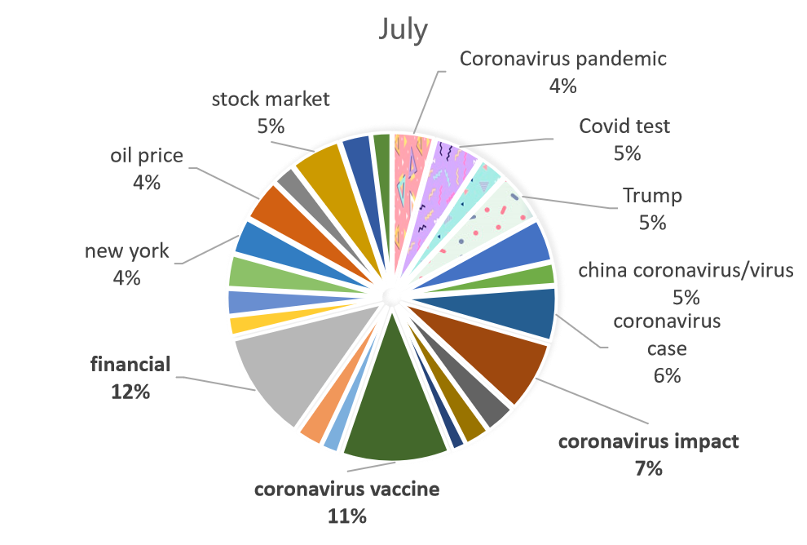
Analysis

Slide 29
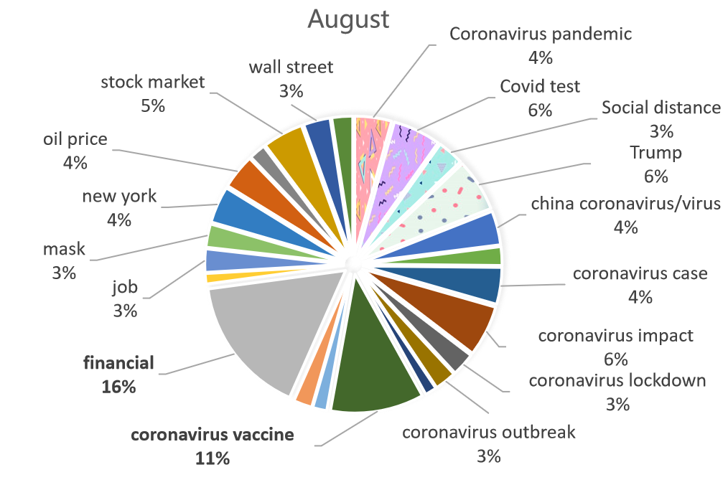
Analysis

Slide 30
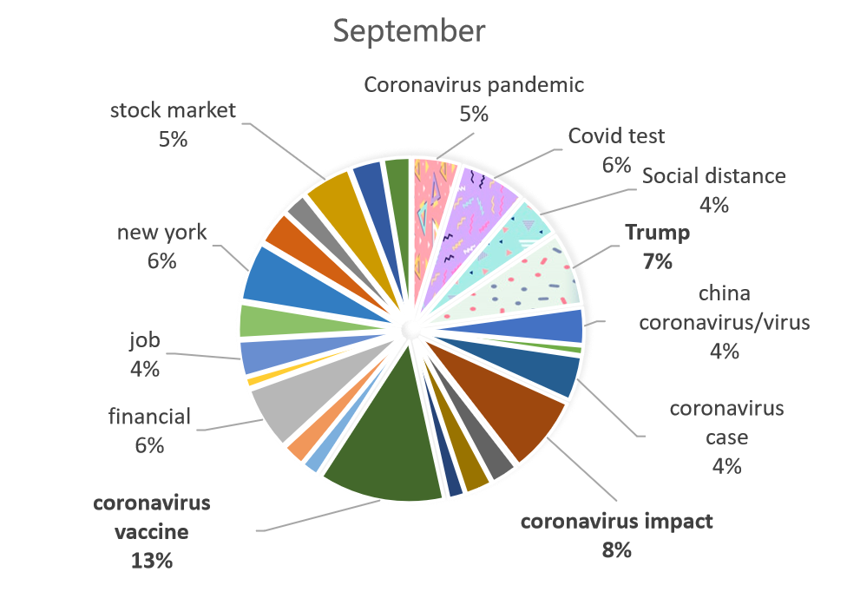
Analysis

Slide 31
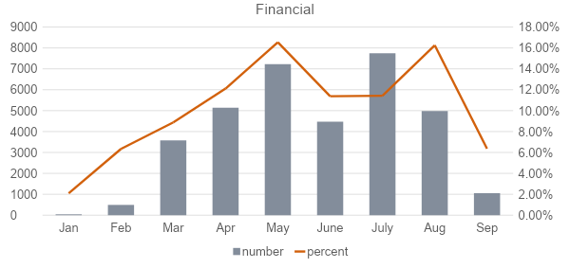
Analysis

Slide 32
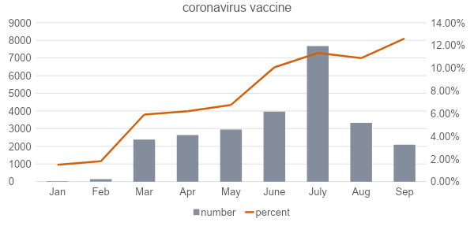
Analysis

Slide 33
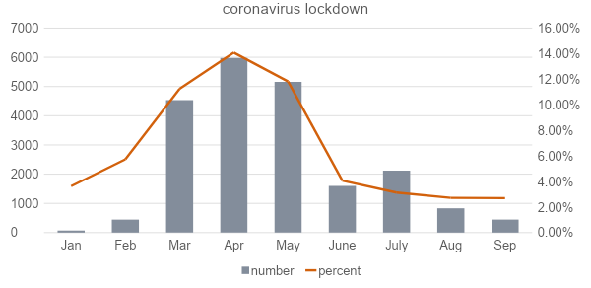
Analysis

Slide 34
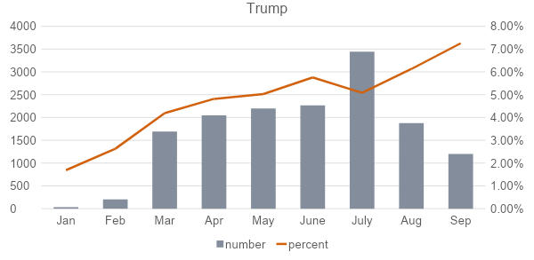
Analysis

Slide 35

Analysis

Slide 36
04
Sentiment-based Topic Analysis

Slide 37


Sentiments around the top 5 topics
More negative sentiments about the impact of coronavirus on financial sector
Thai first-quarter GDP 'not good' as coronavirus hit; second quarter will be worse - Reuters
Harley-Davidson's results likely to reflect another quarter of coronavirus pain
James Bond car maker Aston Martin sees sales half in second quarter as showrooms shut during coronavirus crisis
Coronavirus Causes Stock Market to Drop More Than 100 Points
Jim Cramer: Coronavirus may push unrelated stocks into discount range
Stock market live updates: Dow down 400, biggest coronavirus losers, oil bear market

Slide 38



Sentiments around the top 5 topics
Positive sentiments around efforts to fight coronavirus
https://github.com/workhardzy/K6312.git
US fast-tracks coronavirus vaccine, hopes to start trial in three months
Irish pubs to finally reopen after longest coronavirus lockdown in Europe
DAVOS-Trump says U.S. in 'great shape' with plan for coronavirus
Alibaba's Jack Ma donates $14 million to develop coronavirus vaccine - CNN
China's coronavirus lockdown strategy: brutal but effective | World news | The Guardian
Trump says he is speeding help to farmers hurt by coronavirus dislocation - Reuters

Slide 39
05
Discussion

Slide 40
Key takeaways
Most topics covered by the news outlets on the topic of COVID revolves around five main topics: 1) financial, 2) coronavirus vaccine, 3) coronavirus lockdown, 4) Trump, 5) stock market
Overall, the sentiment was balanced:
More positive than negative → Optimism about beating the virus
Sentiments around the top five topics indicate that:
negative sentiment around the financial impact of the virus
positive sentiments around the measures to fight the virus

Slide 41
Key limitations
More fine-tuning of models could be done
Due to time constraints, not much fine-tuning was done
Our approach was to use different models to see what works
Random Search of hyperparameters on CNN (5 iterations)
Possible avenues to increase robustness of sentiment analysis → transfer learning or to use pre-trained transformer models such as BERT
High training time for LDA and CNN
Contributing to time constraints
Tuning LDA for interpretable topics and topic classification took days
CNN takes hours to train
Simpler models such SVM, LR, ADA, GB are not as time intensive as LDA and CNN

Slide 42
THANK YOU

